Slide 1


Docker Kubernetes

Slide 2

Vagrant
Vagrant
It leverages a declarative configuration file which describes all your software requirements, packages, operating system configuration, users, and more.
Vagrant aims to mirror production environments by providing the same operating system, packages, users, and configurations, all while giving users the flexibility to use their favorite editor, IDE, and browser.
Vagrant works on Mac, Linux, Windows, and more.

Slide 3




Vagrant Providers
Vagrant
VirtualBox
Vmware
Docker
Hyper-v
libvirt (on LXC, KVM/QEMU, Xen, VMWare ESX)

Slide 4
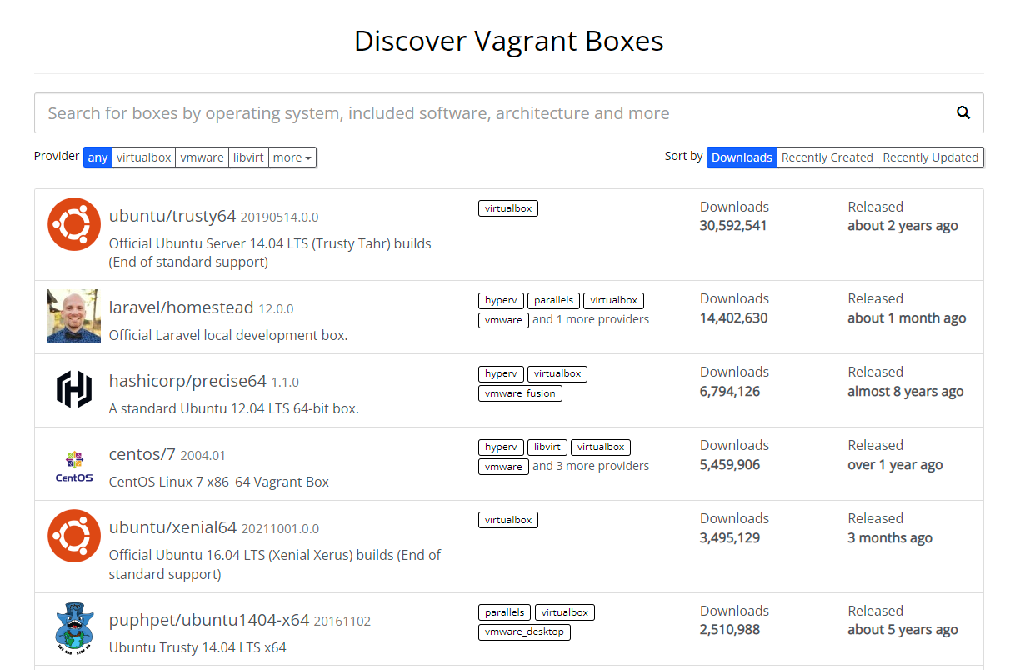
Vagrant Boxes
Vagrant
Base OS, Base OS + packages
(Box Search) https://app.vagrantup.com/boxes/search

Slide 5
Box Provision Procedures
Vagrant
Vagrant 초기화(vagrant init)
설정 변경(Vagrantfile)
가상머신 power on(vagrant up)
가상머신 접속(vagrant ssh <가상머신 이름>)
가상머신 power off(vagrant halt <가상머신 이름>)
가상머신 삭제(vagrant destroy <가상머신 이름>)
(Box Search) https://app.vagrantup.com/boxes/search

Slide 6
Vagrantfile 설정
Vagrant
$ cd docker-k8s-hands-on/lab/day1/lab4
$ vagrant init
$ vi Vagrantfile
$ vagrant up
# VirtualBox 에서 생성된 가상머신 확인
# 또는
$ vagrant status Current machine states:
default running (virtualbox)
The VM is running. To stop this VM, you can run `vagrant halt` to
shut it down forcefully, or you can run `vagrant suspend` to simply
suspend the virtual machine. In either case, to restart it again,
simply run `vagrant up`.
# 가상머신 진입
$ vagrant ssh default
$ cat /etc/redhat-release
# -*- mode: ruby -*-
# vi: set ft=ruby :
# All Vagrant configuration is done below. The "2" in Vagrant.configure
# configures the configuration version (we support older styles for
# backwards compatibility). Please don't change it unless you know what
# you're doing.
Vagrant.configure("2") do |config|
# The most common configuration options are documented and commented below.
# For a complete reference, please see the online documentation at
# https://docs.vagrantup.com.
# Every Vagrant development environment requires a box. You can search for
# boxes at https://vagrantcloud.com/search.
config.vm.box = "bento/centos-7.7"
(주의) PowerShell에서는 커맨드가 정상 작동하나 WSL Ubuntu 20-04 쉘에서는 vagrant 를 설치해야 한다.

Slide 7
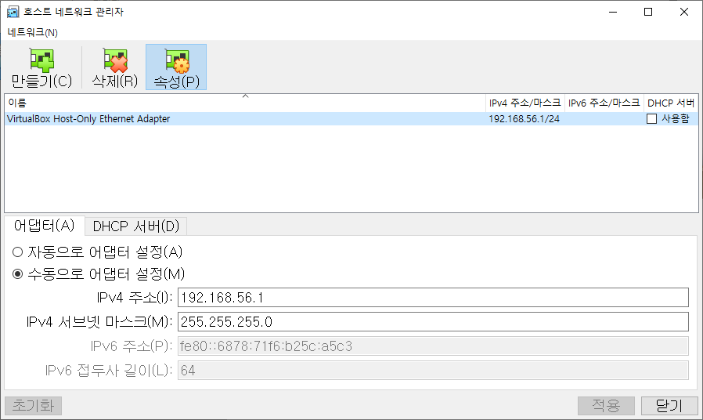
(!) 호스트 네트워크가 작동하지 않을 때
Vagrant
Oracle VM VirtualBox 관리자에서
파일 -> 호스트 네트워크 관리자 선택
DHCP 서버 : 사용함 언체크
IPv4 주소 : 192.168.1.1

Slide 8
k8s 노드 구성을 위한 Vagrantfile
Vagrant

Slide 9
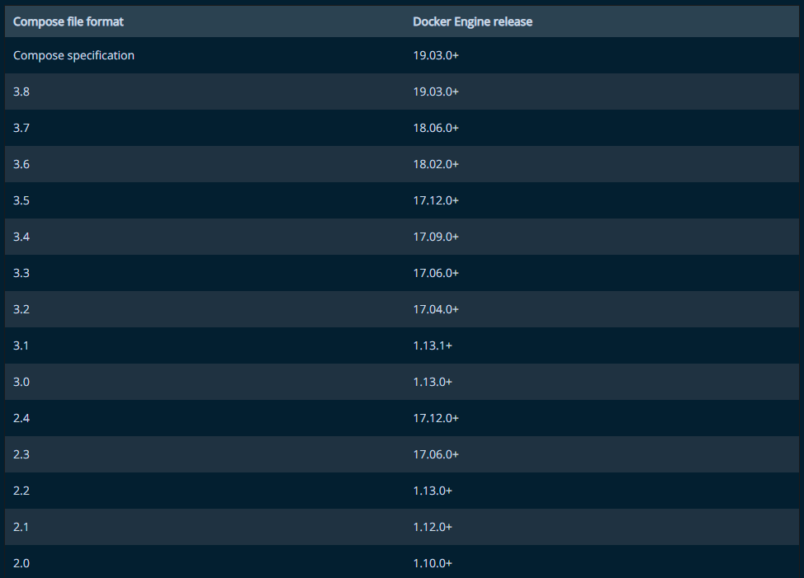
Compose file format vs Docker Engine versions
Docker Compose
version: "3.7"
services:
db:
image: mysql:8.0.19
restart: always
environment:
- MYSQL_DATABASE=example
- MYSQL_ROOT_PASSWORD=password
app:
build: app
web:
build: web
restart: always
ports:
- 80:80
(Compose Specification) https://docs.docker.com/compose/compose-file/

Slide 10
Environment Variables & run
Docker Compose
MYSQL_DATABASE=example
MYSQL_ROOT_PASSWORD=password
version: "3.7"
services:
db:
image: mysql:8.0.19
restart: always
environment:
- MYSQL_DATABASE=${MYSQL_DATABASE}
- MYSQL_ROOT_PASSWORD=${MYSQL_ROOT_PASSWORD}
app:
build: app
web:
build: web
restart: always
ports:
- 80:80
$ docker-compose \
–-env-file=.env \
up -d
.env
docker-compose
(Compose Specification) https://docs.docker.com/compose/compose-file/

Slide 11
Split Environments
Docker Compose
환경 | env file | 설명 | 실행
local | ./config/local.env | 개발 환경 | docker-compose --env-file=./config/local.env
test | ./config/test.env | 테스트 | docker-compose --env-file=./config/test.env
stage | ./config/stage.env | Release 직전 확인 | docker-compose --env-file=./config/stage.env
production | ./config/prod.env | 운영 | docker-compose --env-file=./config/prod.env

Slide 12
Simple Application #1
Docker Compose
# WSL(Ubuntu-20.04) docker-k8s-hands-on 디렉토리로 이동
$ cd docker-k8s-hands-on
# awesome-compose/nginx-golang 디렉토리로 이동
$ cd awesome-compose/nginx-golang
# 디렉토리 구성 확인
$ sudo apt install tree
$ tree
.
├── README.md
├── backend
│ ├── Dockerfile
│ └── main.go
├── docker-compose.yml
└── frontend
├── Dockerfile
└── nginx.conf
2 directories, 6 files
# docker-compose 실행
$ docker-compose up –d
# docker container 확인
$ docker ps
…(중략)…
# 브라우저에서 확인
$ curl localhost:80
## .
## ## ## ==
## ## ## ## ## ===
/"""""""""""""""""\___/ ===
{ / ===-
\______ O __/
\ \ __/
\____\_______/
Hello from Docker!
# stop
$ docker-compose down

Slide 13
Simple Application #2
Docker Compose
# WSL(Ubuntu-20.04) docker-k8s-hands-on 디렉토리로 이동
$ cd docker-k8s-hands-on
# awesome-compose/wordpress-mysql 디렉토리로 이동
$ cd awesome-compose/wordpress-mysql
# 디렉토리 구성 확인
$ tree
.
├── README.md
├── docker-compose.yaml
└── output.jpg
0 directories, 3 files
# docker-compose 실행
$ docker-compose up –d
# docker container 확인
$ docker ps
…(중략)…
# 브라우저에서 확인
# stop
$ docker-compose down

Slide 14
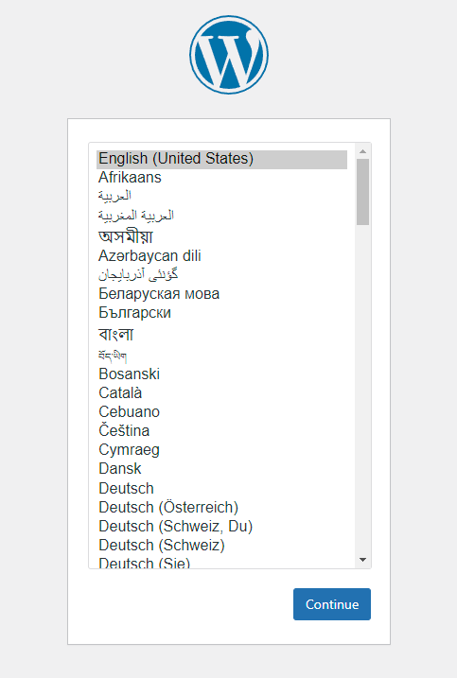
Simple Application #2
Docker Compose

Slide 15
Docker volume mount path(console)
Docker Compose
$ docker inspect wordpress-mysql_db_data
..(중략)…
"Mountpoint": "/var/lib/docker/volumes/wordpress-mysql_db_data/_data",
# 윈도우 wsl (powershell 에서)
PS C:\Users\Public\Documents> cd \\wsl$\docker-desktop-data\version-pack-data\community\docker\volumes\
PS Microsoft.PowerShell.Core\FileSystem::\\wsl$\docker-desktop-data\version-pack-data\community\docker\volumes> dir
디렉터리: \\wsl$\docker-desktop-data\version-pack-data\community\docker\volumes
Mode LastWriteTime Length Name
---- ------------- ------ ----
d----- 2022-01-14 오전 11:09 22106252766b8961e69f994bc0837d93dca3d83a504849b4f54d2f895be8c35d
d----- 2022-01-14 오전 11:09 wordpress-mysql_db_data
-----l 2022-01-13 오후 8:17 0 backingFsBlockDev
------ 2022-01-14 오전 11:09 32768 metadata.db

Slide 16
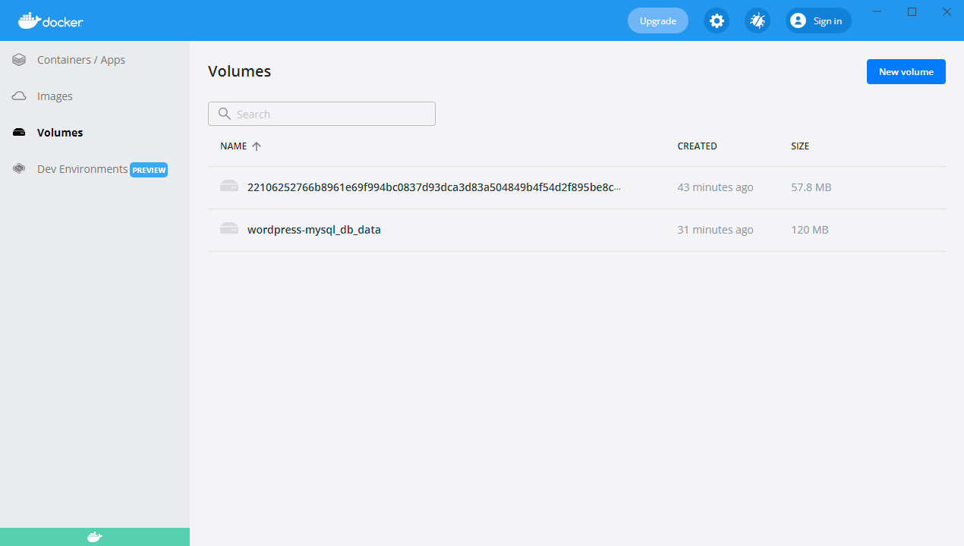
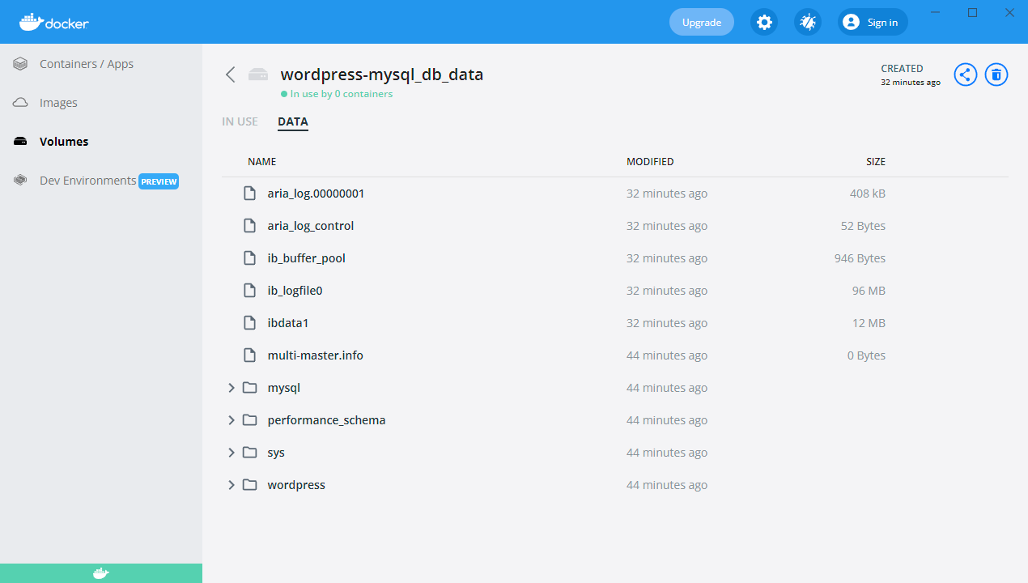
Docker volume mount path(Docker Desktop)
Docker Compose

Slide 17
More references docker compose
Docker Compose
(docker compose 와 버전별 특징) https://meetup.toast.com/posts/277
(docker 및 docker compose 명령어 정리) https://dockerlabs.collabnix.com/docker/cheatsheet/

